Slide 1
The for Loop

Slide 2
Relational and Logical Operators
A condition is an expression
Involving relational operators (such as < and >=)
Logical operators (such as and, or, and not)
Evaluates to either True or False
Conditions used to make decisions
Control loops
Choose between options

Slide 3

The for Loop
Used to iterate through a sequence of values
General form of a for loop
Sequence can be
Arithmetic progression of numbers
String
List
File object

Slide 4
The for Loop
Variable is successively assigned each value in the sequence
Indented block of statements executed after each assignment
Physical indentation tells interpreter where block starts and stops

Slide 5
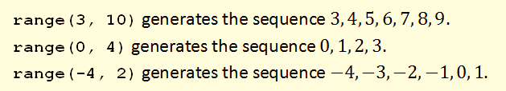
Looping Through Arithmetic Progression of Numbers
Range function is used to generate an arithmetic progression

Slide 6
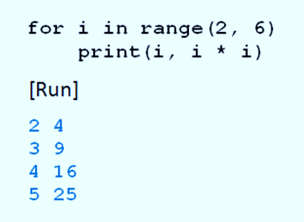
Looping Through Arithmetic Progression of Numbers
Example 1: Code displays four integers and their squares
:

Slide 7
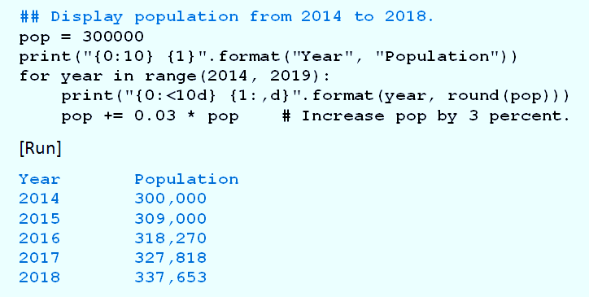
Looping Through Arithmetic Progression of Numbers
Example 2: Program displays a table showing the population each year until 2018.

Slide 8
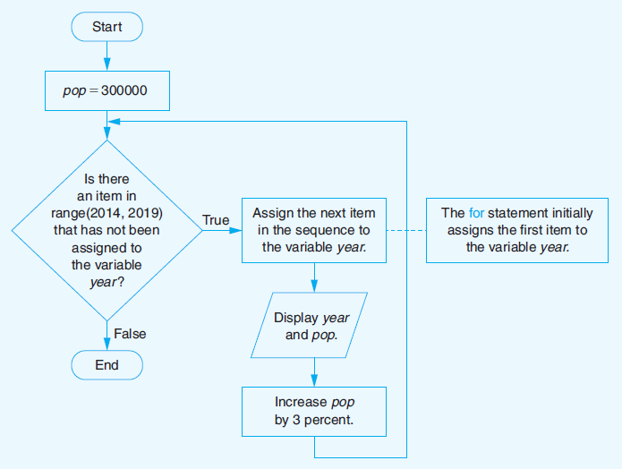
Looping Through Arithmetic Progression of Numbers
FIGURE 3.44 Flowchart for Example 2.

Slide 9
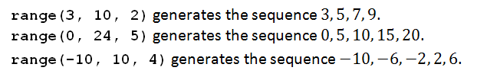
Step Values for the range Function
Variation of the range function generates a sequence of integers
Successive integers differ by a value other than 1
Examples

Slide 10
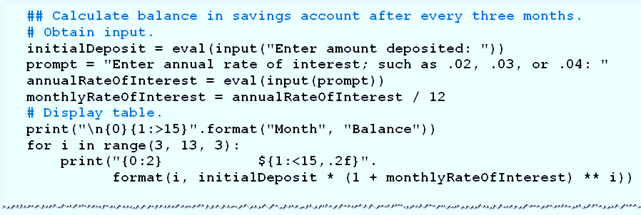
Step Values for the range Function
Example 3: Program requests
amount deposited
annual rate of interest
then calculates balance after each quarter-year for four quarters.

Slide 11
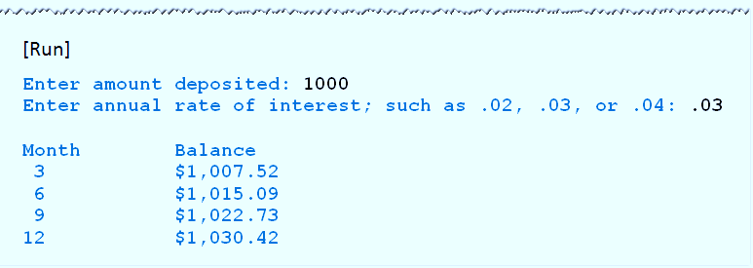
Step Values for the range Function
Example 3, cont.

Slide 12
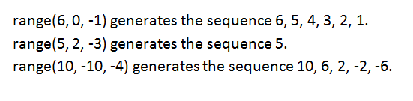
Step Values for the range Function
If negative step value is used and initial value is greater than terminating value,
Range function generates a decreasing sequence
Examples:

Slide 13
Nested for Loops
Body of for loop can contain any type of Python statement
Can contain another for loop.
Second loop must be completely contained inside the first loop
Must have a different loop variable

Slide 14
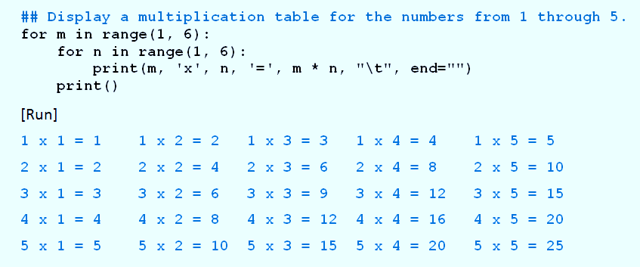
Nested for Loops
Example 4: Program displays a multiplication table for the integers from 1 to 5

Slide 15
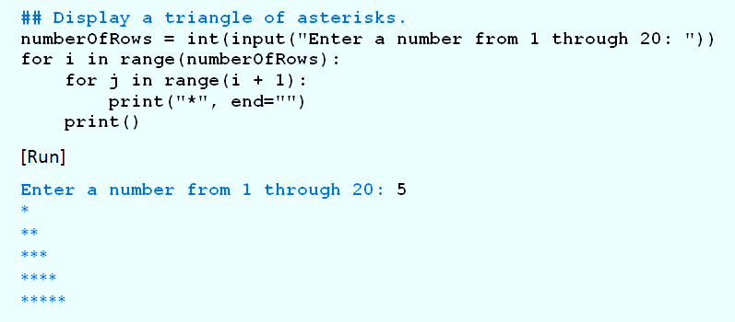
Nested for Loops
Example 5: Program uses nested for loops to display a triangle of asterisks.

Slide 16
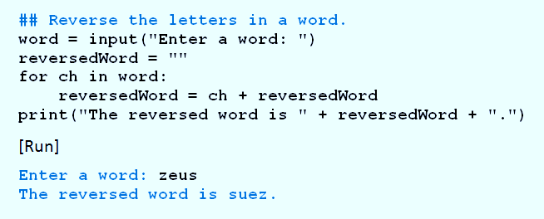
Looping Through Characters of a String
Example 6: Program requests a word as input and displays it backwards.

Slide 17
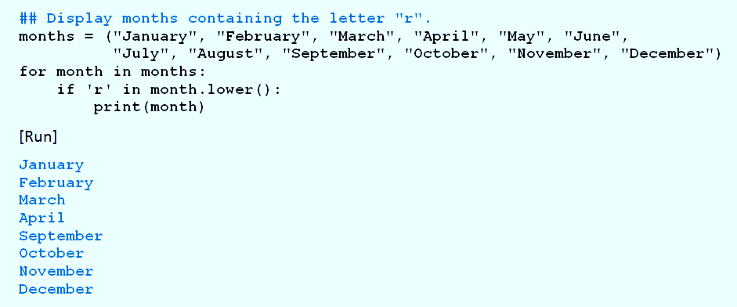
Looping Through Items of a List or Tuple
Example 7: Program displays the months whose names contains the letter r.

Slide 18
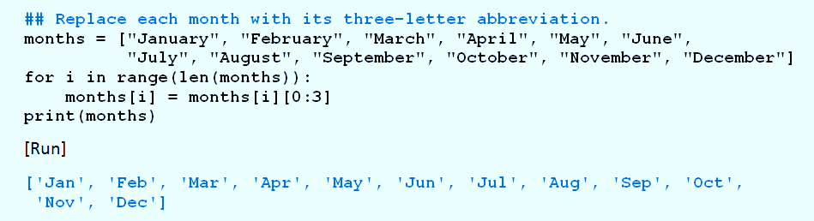
Looping Through Items of a List or Tuple
Example 8: Program replaces the name of each month with its three-letter abbreviation.

Slide 19
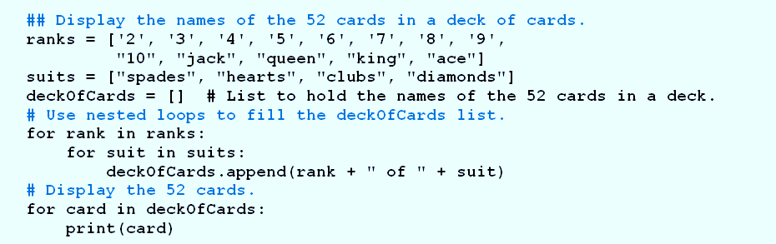
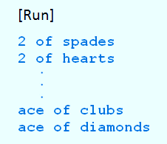
Looping Through Items of a List or Tuple
Example 9: Program uses nested for loops with list of ranks, list of suits
Creates list consisting of 52 cards in deck of cards

Slide 20
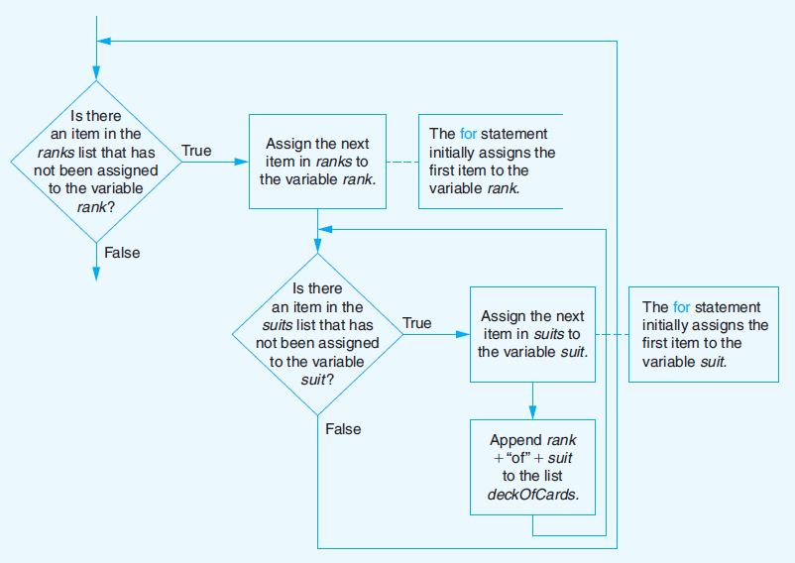
Looping Through Items of a List or Tuple
FIGURE 3.45 Flowchart of nested for loops from Example 9.

Slide 21
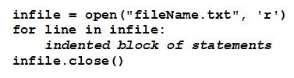
Looping Through Lines of Text File
To open a file for reading use the open() function passing in the file name and the mode(r for reading, w for writing, a for appending). It returns a file object.
Reads each line of the file in succession
Executes indented block of statement(s) for each line
First line establishes connection between program and file

Slide 22
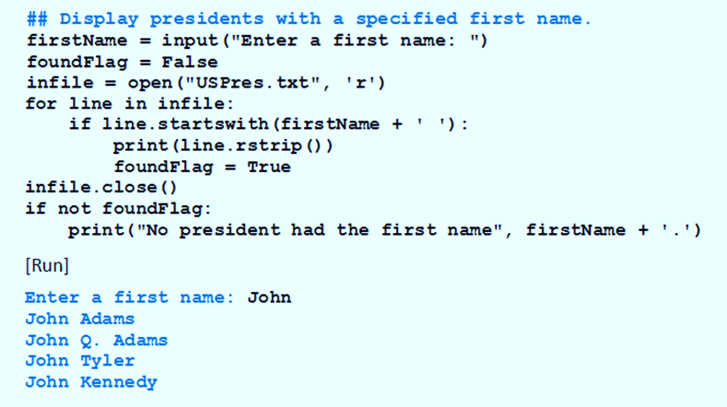
Looping Through Lines of Text File
Example 10: Program requests a first name and then displays names of U.S. presidents having that first name

Slide 23
The pass Statement
There are times when you want loop to cycle through a sequence and not do anything
The pass statement should be used.
The pass statement is a do-nothing placeholder statement

Slide 24
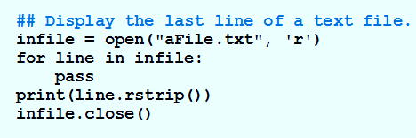
The pass Statement
Example 11: Program displays the last line of a file

Slide 25
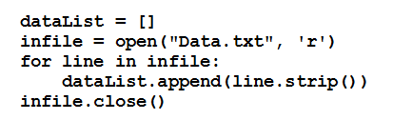
Populating a List with Contents of a Text File
One way of placing the contents of a text file into a list.

Slide 26

Populating a List with Contents of a Text File
This is a more efficient way using list comprehension (to be explained later)

